Slide 1
527 Data Analytics
27th April 2017
Time Series Analysis On Global Temperature Anomaly
By Group 58: Arpitha Jayarama
Roshni Jariwala
Manthan Kapadia

Slide 2
Table of contents
Introduction
Matter of concern
Approach
Achievements along with visualization
Scope of the project
Tableau visualization

Slide 3
Introduction
The aim of this project is to perform time series analysis on the global temperature anomaly.
Time series analysis and forecasting has become a major analysis in numerous applications in meteorology and other environmental areas to understand phenomena, like rainfall, humidity, temperature, draught etc.
Time series is one of the interesting topics in data analytics, we are motivated towards exploring this method of analysis where we are also able to perform future predictions.
The approach is to work on the data based on land-ocean and land-air data which involves analyzing both the areas and coming up with the best model which can predict overall temperature.

Slide 4
Matter of concern
How much important it is to study temperature anomaly?
The term temperature anomaly means a departure from a reference value or long-term average. A positive anomaly indicates that the observed temperature was warmer than the reference value, while a negative anomaly indicates that the observed temperature was cooler than the reference value.
Climate change for many countries in the world is one of the biggest environmental threats to food production, water availability, forest biodiversity and livelihoods.
For that purpose time series analysis of weather data can be a very valuable tool to investigate its variability pattern and, maybe, even to predict short- and long-term changes in the time series.
Although any individual extreme climate event cannot be attributed unequivocally to climate change, the probability of high temperature events will increase if there is an underlying trend of rising mean temperature.
The number of climate-related disasters has increased significantly the 1970’s.

Slide 5
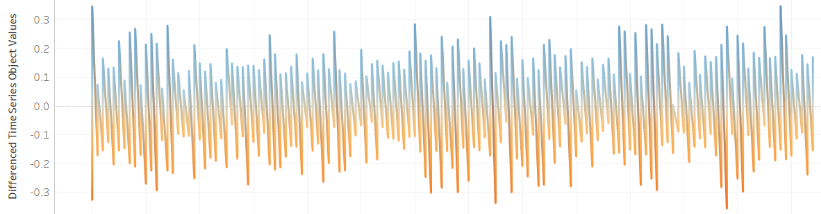
Approach along with visualization
Our dataset is more or less stationary and serially correlated. After performing one step differentiation, we were able to come up with stationary time series.
we performed two types of linear time series modelling, analysis and forecasting: Data based on monthly basis and Data based on yearly basis.
For modelling we are creating different models like AR, MA, ARMA, ARIMA. If we find any seasonality, we go for SARIMA model. But as we don’t have seasonality so we don’t go for SARIMA model.
There are two approaches to select the best model:
Directly selecting the best model based on the metrics like AIC/AICC/BIC right when the model is created and then proceeding with forecasting part taking into consideration this model
Taking all the models into consideration and using them for forecasting. Finally, coming up with the best model which gives the best forecasted values which are very close to actual values in the dataset and then finding its metrics values.

Slide 6
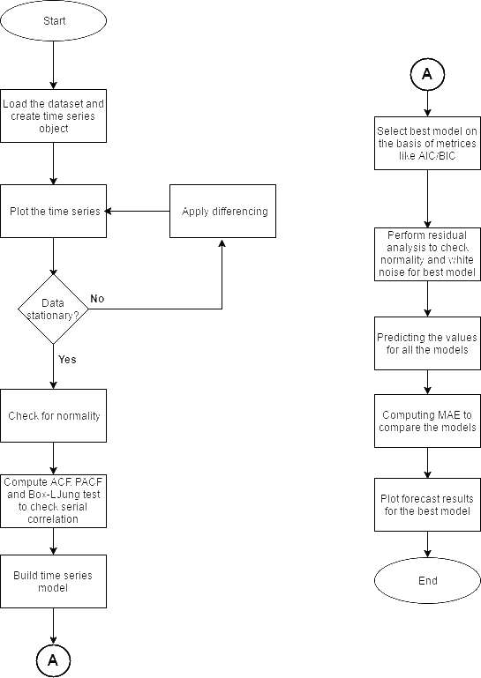
Flow chart of our approach

Slide 7
Achievements
Created different models like AR(p), MA(q) ,ARMA(p ,q)and ARIMA(p,0,q).
We have forecasted future values using these models.
Finally after analyzing the forecasted values, we have decided to go forward with AR model for yearly data analysis and for monthly data, exponential smoothing model. The reason behind this is, forecasted values using this model are very close to the actual values in the dataset.
The best model based on yearly data is used for forecasting and predictions.

Slide 8
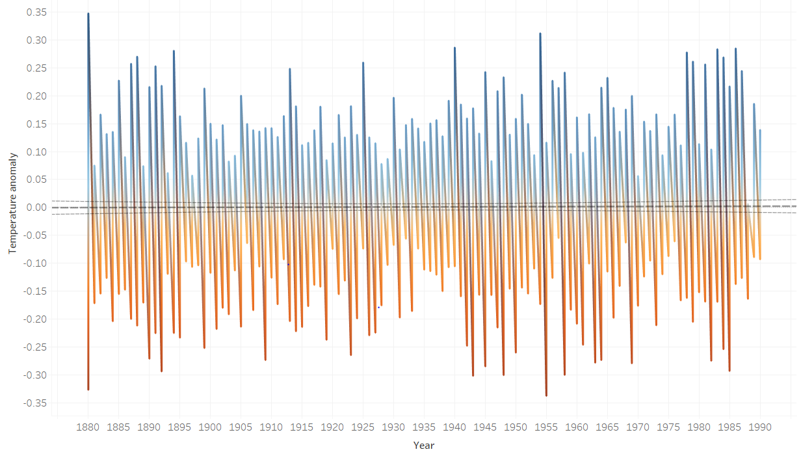
Achievements
Findings based on monthly data analysis
As we can see from the above plot there’s almost no trend in the data. When there’s no trend, we go for exponential smoothing techniques

Slide 9
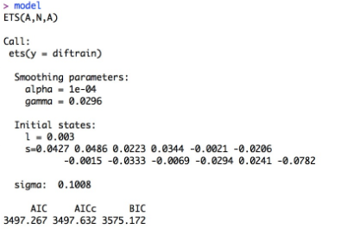
Achievements
Model using exponential smoothing techniques based on monthly data which is used for forecasting is shown below-
Forecasted values achieved using the models mentioned above are shown in the upcoming slides

Slide 10
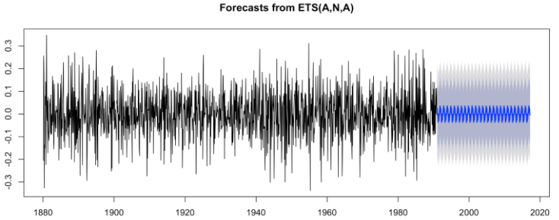
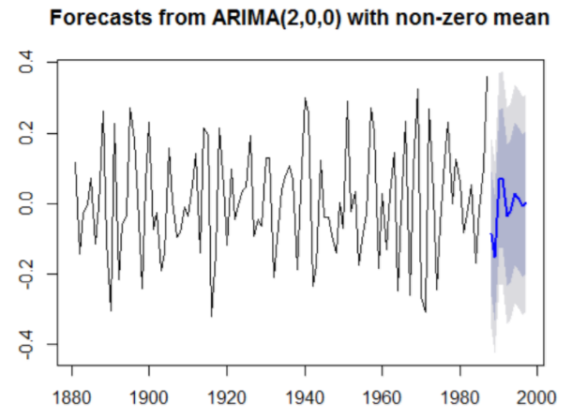
Achievements
Forecasted plot based on monthly data analysis
Forecasted plot based on yearly data analysis

Slide 11
Future scope
There can be improvisations and as a future scope, this project can be used in areas like-
Operational Monitoring
Climate Assessment activities
Meteorological Department

Slide 12

Tableau Visualization

